Slide 1
Biotechnology -DNA Sequencing

Slide 2
What are we doing today?
DNA sequencing of genomes using biotechnological techniques (SU)
Biotechnological techniques provide evidence for evolution by using PCR (to amplify minute samples of DNA to testable amounts), bacterial enzymes and gel electrophoresis to facilitate DNA sequencing of genomes (SU)
Conduct investigations, including the use of virtual or real biotechnological techniques of polymerase chain reaction (PCR), gel electrophoresis for deoxyribonucleic acid (DNA)sequencing, and techniques for relative and absolute dating, safely, competently and methodically for valid and reliable collection of data (SIS)

Slide 3
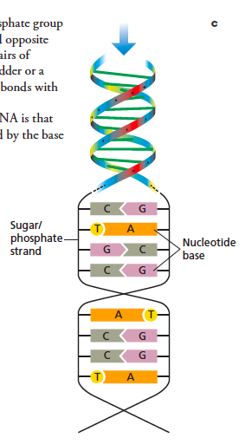
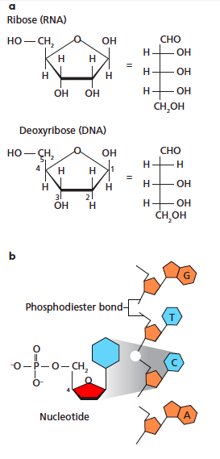
DNA Structure
The DNA sugar ring is called deoxyribose.
In ribonucleic acid (RNA), the sugar ring is ribose.
Figure 1.7

Slide 4
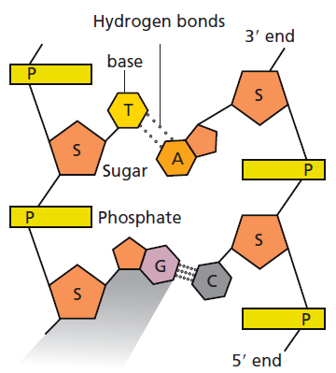
Structure of DNA
The four nucleotides in DNA are:
A – adenine
T – thymine
G – guanine
C – cytosine
In DNA,
A always pairs with T
G always pairs with C
This is Chargaff’s rule.
Nitrogenous bases of opposite DNA strands are held together by hydrogen bonds.
A and T have two hydrogen bonds.
G and C form three bonds.
Figure 1.7
DNA has directionality:
the phosphate is at the 5’ end
the sugar is at the 3’ end
DNA is ‘read’ from 5’ to 3’

Slide 5
DNA replication
The first step in DNA replication is to ‘unzip’ the double helix structure of the DNA molecule.
This is carried out by an enzyme called helicase which breaks the hydrogen bonds holding the complementary bases of DNA together (A with T, C with G).
The separation of the two single strands of DNA creates a ‘Y’ shape called a replication ‘fork’. The two separated strands will act as templates for making the new strands of DNA.
A short piece of RNA called a primer (produced by an enzyme called primase) comes along and binds to the end of the leading strand. The primer acts as the starting point for DNA synthesis.
DNA polymerase binds to the leading strand and then ‘walks’ along it, adding new complementary nucleotide bases (A, C, G and T) to the strand of DNA in the 5’ to 3’ direction.
Notes:
https://www.youtube.com/watch?v=8kK2zwjRV0M
https://www.youtube.com/watch?v=5qSrmeiWsuc

Slide 6
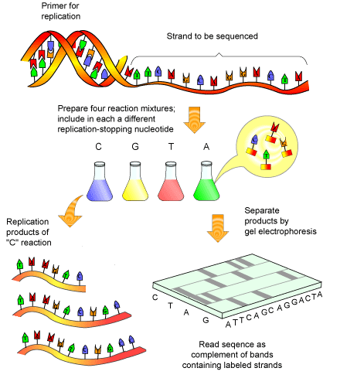
DNA sequencing
What is it?
Working out the precise order of nucleotides in a sample of DNA
Uses
Identifying Inherited diseases
Paternity/maternity tests
Tracing ancestry
Forensic science

Slide 7
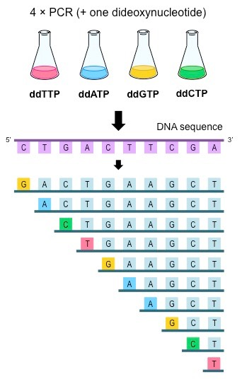
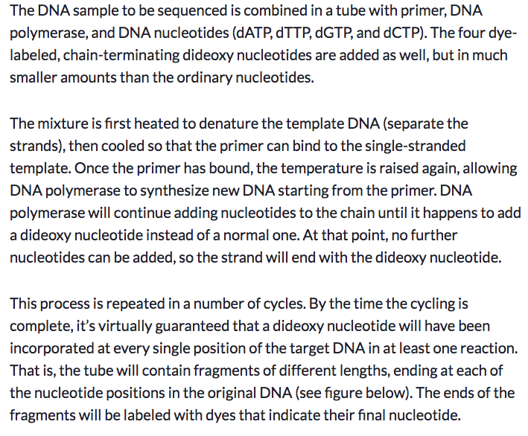
Sanger sequencing
Notes:
https://www.youtube.com/watch?v=3M0PyxFPwkQ

Slide 8
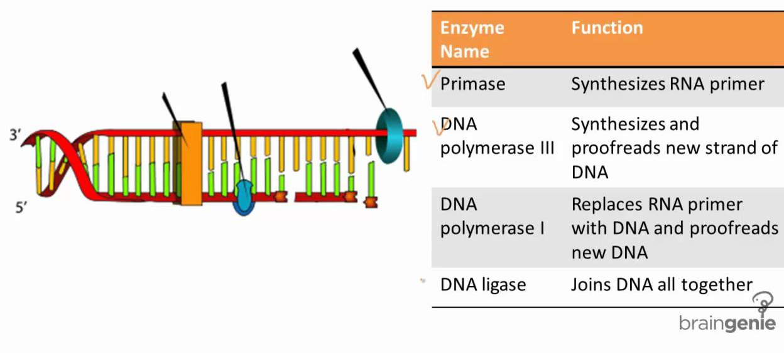
Enzymes
Restriction enzymes ‘recognise’ and cut DNA molecules at specific locations.
Many hundreds of different restriction enzymes have been isolated from microbes and are available commercially.
Allow almost any section of DNA, and so any given gene, to be isolated.
Restriction enzymes leave blunt or staggered (‘sticky’) ends on the DNA sequences they cut.
The end of one DNA molecule with a sticky end will readily link (by hydrogen bonding) to that of another cut with the same enzyme.
DNA ligase- joins two DNA molecules permanently, by forming stronger chemical bonds along the DNA’s sugar-phosphate backbone.
DNA polymerase — can be used to assemble a double-stranded helix, using the first DNA strand as a template.

Slide 9
Polymerase chain reaction
Materials
Two primers are made that flank the specific stretch of DNA to be copied. These are generally 15–30 bases long, and are complementary to the 5' end of each DNA strand.
Total(double-stranded )DNA is extracted from the sample under study.
The DNA and excess primers are mixed.
Equal proportions of very pure deoxyribonucleoside triphosphates (dCTP, dATP, dGTP, dTTP) are added.
Heat-stable Taq DNA polymerase (originally obtained from the hot- water bacterium Thermus aquaticus, but now produced by genetically- modified organisms) is added to the reaction mix, together with Mg2+ ions that are required as a co-factor by the enzyme.
Method
The double-stranded DNA is split into two single-stranded templates by heating it to 95–98 °C.
The mixture is cooled to 50–65 °C. The primers bind (hybridise) to the complementary strands of DNA.
Heating to7 2°C (the optimum temperature for Taq DNA polymerase) encourages the synthesis of new DNA strands alongside the templates.
The mixture is heated again to separate the newly-formed DNA strands from their partners.
The cycle of cooling and heating is repeated. With each cycle (lasting about 2 minutes) the number of copies of the template DNA is doubled. After 25 cycles more than a million copies of the DNA will have been made.

Slide 10
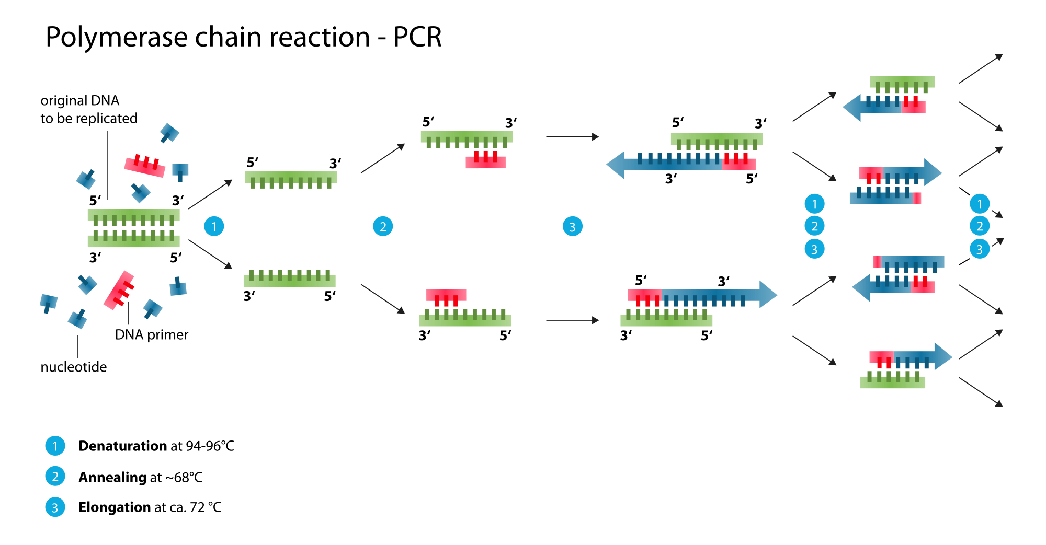
Polymerase chain reaction
Notes:
https://www.youtube.com/watch?v=Nl6eLez3CNI
https://www.youtube.com/watch?v=VD5qEVTsjTc

Slide 11
Gel Electrophoresis
Can be used to separate DNA fragments of different sizes, which is often the first step in their analysis.
First, a gel is cast from agarose — a very pure form of agar, which is obtained from seaweed.
At one end of the gel are several small wells.
A buffer solution is poured over the gel. Ions in the buffer solution conduct electricity. The buffer also stops the gel from drying out.
The invisible DNA fragments are mixed with a small volume of loading dye. This dye is dissolved in a dense sugar solution, so that when it is added to the wells, it sinks to the bottom, taking the DNA with it.
A current is applied to the electrodes, setting up an electrical field across the gel.
DNA migrates through the gel towards the positive electrode.
Small fragments move quickly through the porous gel — larger fragments travel more slowly.
Pieces of DNA are separated by size. The loading dye also moves through the gel, so that the progress of the electrophoresis can be seen.
After electrophoresis, the gel is stained to reveal the DNA, either as a smear (many fragments of a wide range of sizes) or bands (each band is comprised of numerous DNA fragments of a similar size).
Notes:
https://www.youtube.com/watch?v=ZDZUAleWX78

Slide 12
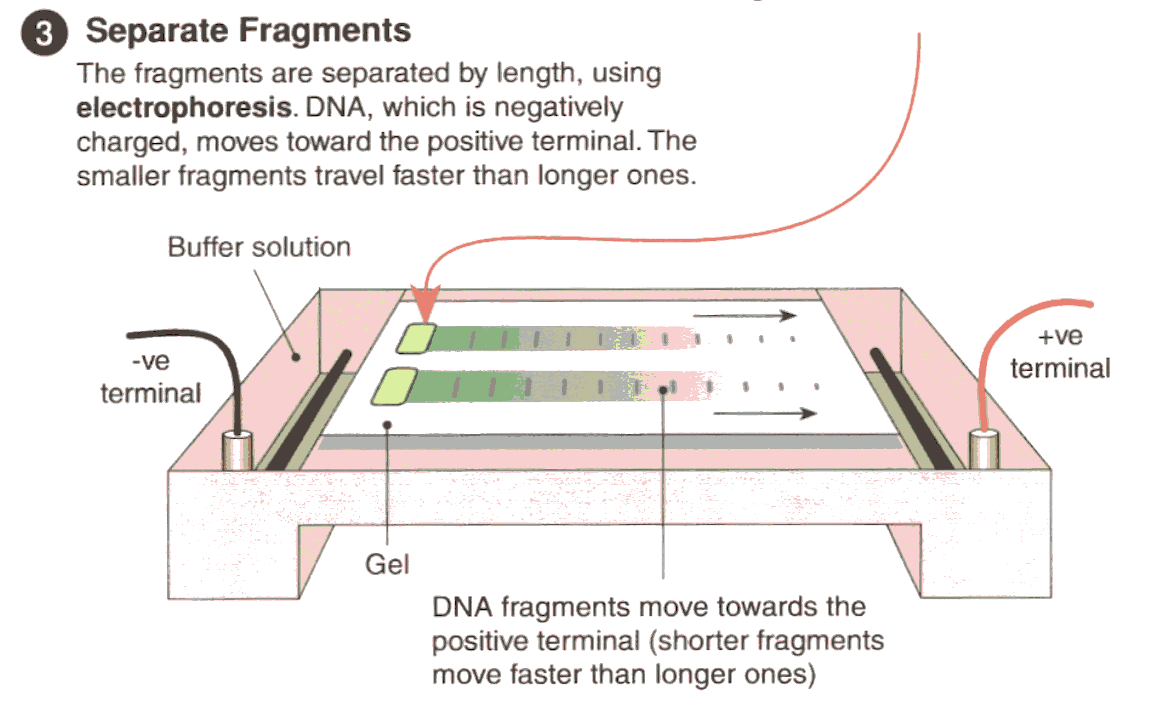
Gel Electrophoresis
Fragments separated by length
DNA (negatively charged)
Moves towards +ve terminal
Shorter fragments move faster
Notes:
https://www.youtube.com/watch?v=ZDZUAleWX78

